Slide 1
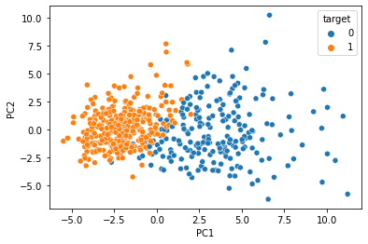
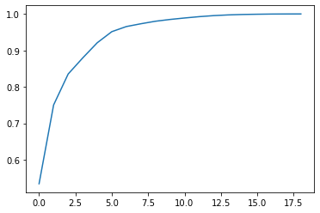
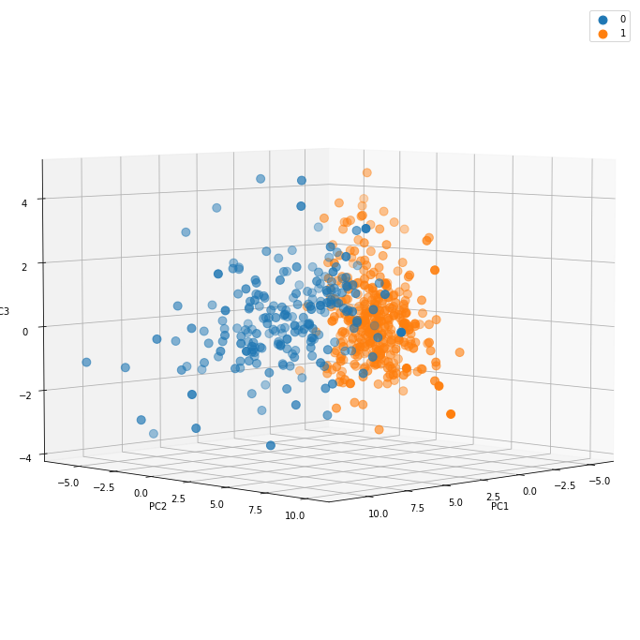
PCA analysis

Slide 2
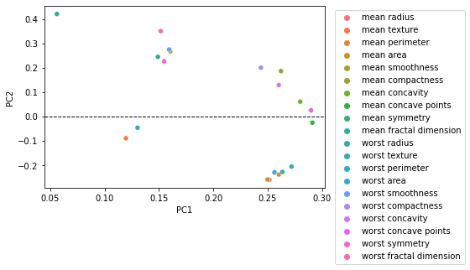
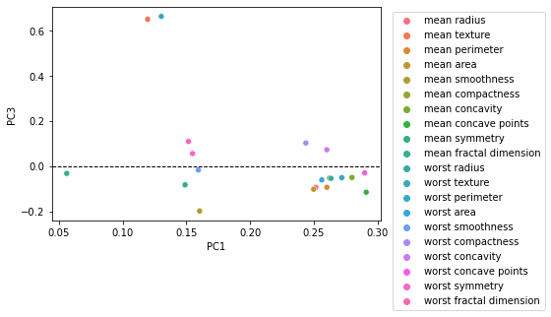
Important variables:
Mean fractal dimension & worst FD
Mean symmetry & worst symmetry
Mean area & worst area
Mean smoothness worst smoothness
Mean perimeter & worst perimeter
Mean texture & worst texture
Important variables:
Mean fractal dimension & worst FD
Mean symmetry & worst symmetry
Mean area & worst area
Mean smoothness worst smoothness
Mean perimeter & worst perimeter
Mean texture & worst texture

Slide 3
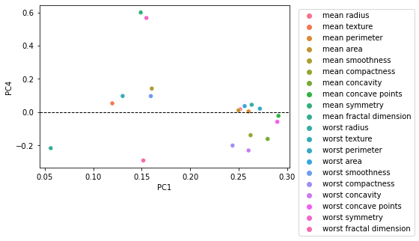
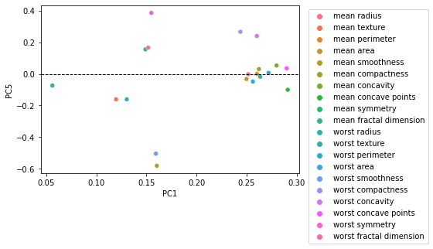
Important variables:
Mean fractal dimension & worst FD
Mean symmetry & worst symmetry
Mean area & worst area
Mean smoothness worst smoothness
Mean perimeter & worst perimeter
Mean texture & worst texture
Important variables:
Mean fractal dimension & worst FD
Mean symmetry & worst symmetry
Mean area & worst area
Mean smoothness worst smoothness
Mean perimeter & worst perimeter
Mean texture & worst texture

Slide 4
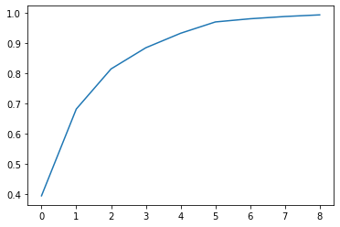
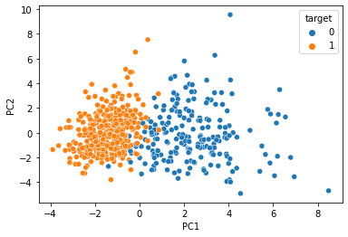
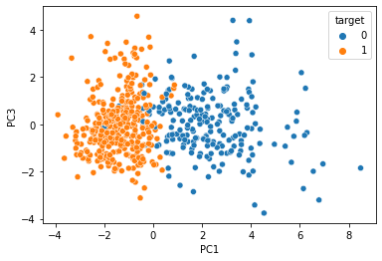
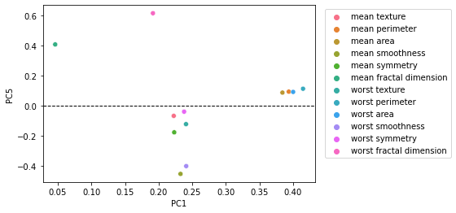
PCA analysis: after dropping 8 variables

Slide 5
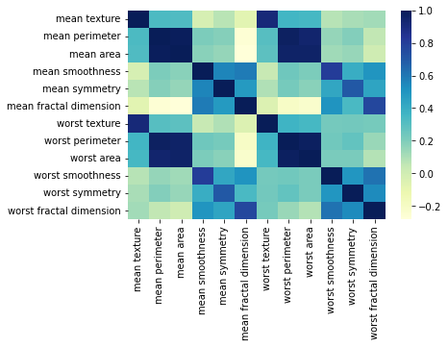
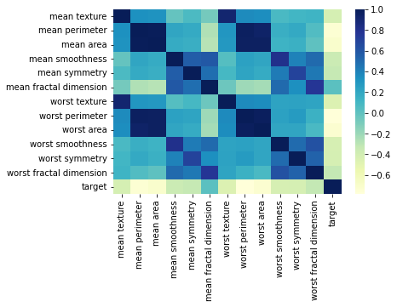

Slide 6
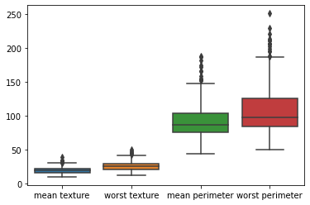
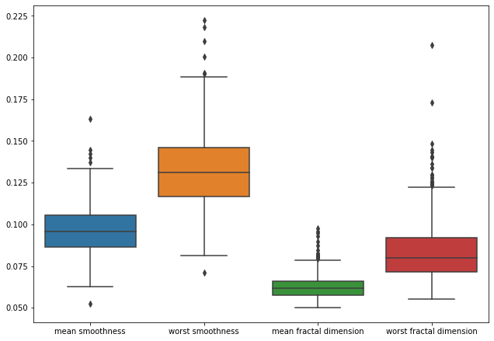
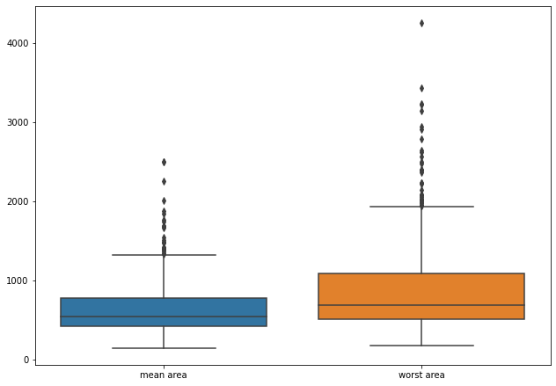
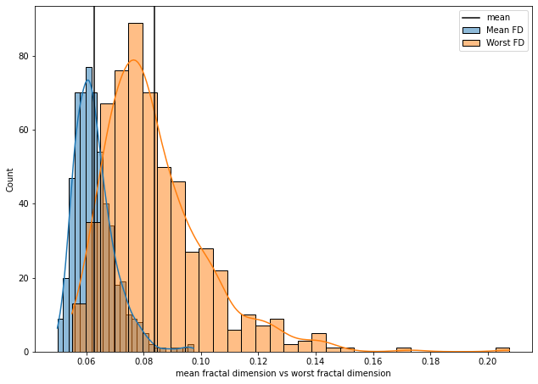

Slide 7
